Slide 1
Operator Overloading and Type Conversions

Slide 2
INTRODUCTION
Operator overloading is one of the many exciting features of C++ language.
It is an important technique that has enhanced the power of extensibility of C++.
We have stated more than once that C++ tries to make the user-defined data types behave in much the same way as the built-in types.
C++ has the ability to provide the operators with a special meaning for a data type. The mechanism of giving such special meanings to an operator is known as operator overloading.

Slide 3
INTRODUCTION
Operator overloading provides a flexible option for the creation of new definitions for most of the C++ operators
  Class member access operators (., .*).
  Scope resolution operator (::).
  Size operator (sizeof).
  Conditional operator (?:).

Slide 4
DEFINING OPERATOR OVERLOADING
The general form of an operator function is:
return type classname :: operator op(arglist)
{
Function body // task defined
}
where
  return type is the type of value returned by the specified operation
  op is the operator being overloaded.
  operator op is the function name, where operator is a keyword.

Slide 5
DEFINING OPERATOR OVERLOADING
Operator functions must be either member functions (nonstatic) or friend functions.
A basic difference between them is that a friend function will have only one argument for unary operators and two for binary operators, while a member function has no arguments for unary operators and only one for binary operators.
This is because the object used to invoke the member function is passed implicitly and therefore is available for the member function.

Slide 6
DEFINING OPERATOR OVERLOADING
This is not the case with friend functions. Arguments may be passed either by value or by reference.
Operator functions are declared in the class using prototypes as follows:
vector operator+(vector); //vector addition
vector operator-(); //unary minus
friend vector operator+(vector,vector); //vector addition friend vector operator-(vector); //unary minus
vector operator-(vector &a); // subtraction
int operator==(vector); //comparison
friend int operator==(vector,vector)//comparison

Slide 7
DEFINING OPERATOR OVERLOADING
The process of overloading involves the following steps:
1. Create a class that defines the data type that is to be used in the overloading operation.
2. Declare the operator function operator op() in the public part of the class. It may be either a member function or a friend function.
3. Define the operator function to implement the required operations.
4. Overloaded operator functions can be invoked by expressions such as
op x or x op
for unary operators x op y

Slide 8
DEFINING OPERATOR OVERLOADING
For binary operators:
op x (or x op)
would be interpreted as
operator op (x)
for friend functions.
Similarly, the expression x op y would be interpreted as either
x.operator op (y)
in case of member functions, or
operator op (x,y)

Slide 9
OVERLOADING UNARY OPERATORS
A minus operator when used as a unary, takes just one operand.
We know that this operator changes the sign of an operand when applied to a basic data item.
The unary minus when applied to an object should change the sign of each of its data items.

Slide 10
OVERLOADING UNARY OPERATORS
Remember, a statement like
S2 = -S1;
will not work because, the function operator-() does not return any value. It can work if the function is modified to return an object.
It is possible to overload a unary minus operator using a friend function as follows:
friend void operator-(space &s);// declaration
void operator-(space &s)// definition
{
s.x = -s.x; s.y = -s.y; s.z = -s.z;
}

Slide 11
OVERLOADING BINARY OPERATORS
The same mechanism can be used to overload a binary operator.
A statement like
C = sum(A, B); // functional notation.
was used. The functional notation can be replaced by a natural looking expression
C = A + B; // arithmetic notation
by overloading the + operator using an operator+() function.

Slide 12
OVERLOADING BINARY OPERATORS
complex complex :: operator+(complex c)
{
complex temp;
temp.x = x + c.x;
temp.y = y + c.y;
return(temp);
}
We should note the following features of this function:
1. It receives only one complex type argument explicitly. 2. It returns a complex type value.
3. It is a member function of complex.

Slide 13
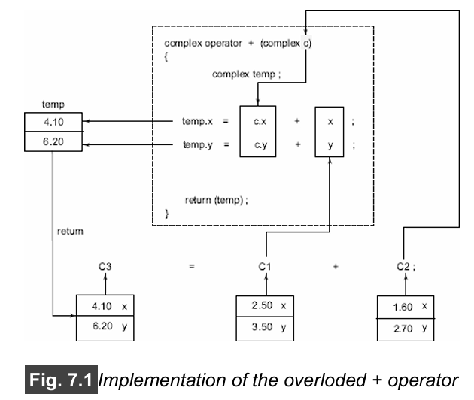
OVERLOADING BINARY OPERATORS

Slide 14
OVERLOADING BINARY OPERATORS USING FRIENDS
The complex number program discussed in the previous section can be modified using a friend operator function as follows:
Replace the member function declaration by the friend function declaration. friend complex operator+(complex, complex);
Redefine the operator function as follows:
complex operator+(complex a, complex b)
{
return complex((a.x+b.x),(a.y+b.y));
}

Slide 15
OVERLOADING BINARY OPERATORS USING FRIENDS
In this case, the statement
C3 = C1 + C2;
is equivalent to
C3 = operator+(C1, C2);

Slide 16
MANIPULATION OF STRINGS USING OPERATORS
One of the main drawbacks of string manipulations in C is that whenever a string is to be copied, the programmer must first determine its length and allocate the required amount of memory.
For example, we shall be able to use statements like string3 = string1 + string2;
if(string1 >= string2)
string = string1;

Slide 17
SOME OTHER OPERATOR OVERLOADING EXAMPLES
Overloading the Subscript Operator []

Slide 18
SOME OTHER OPERATOR OVERLOADING EXAMPLES
Overloading the Pointer-to-member (->) Operator

Slide 19
RULES FOR OVERLOADING OPERATORS
Some of them are listed below:
Only existing operators can be overloaded. New operators cannot be created.
The overloaded operator must have at least one operand that is of user-defined type.
Overloaded operators follow the syntax rules of the original operators. They cannot be overridden.
There are some operators that cannot be overloaded. (See Table 7.1.)

Slide 20
RULES FOR OVERLOADING OPERATORS
Some of them are listed below:
5. We cannot use friend functions to overload certain operators. (See Table 7.2.) However, member functions can be used to overload them.
6. Unary operators, overloaded by means of a member function, take no explicit arguments and return no explicit values, but, those overloaded by means of a friend function, take one reference argument (the object of the relevant class).

Slide 21
RULES FOR OVERLOADING OPERATORS
Some of them are listed below:
7. Binary operators overloaded through a member function take one explicit argument and those which are overloaded through a friend function take two explicit arguments.
8. When using binary operators overloaded through a member function, the left hand operand must be an object of the relevant class.
9. Binary arithmetic operators such as +, -, *, and / must explicitly return a value. They must not attempt to change their own arguments.

Slide 22
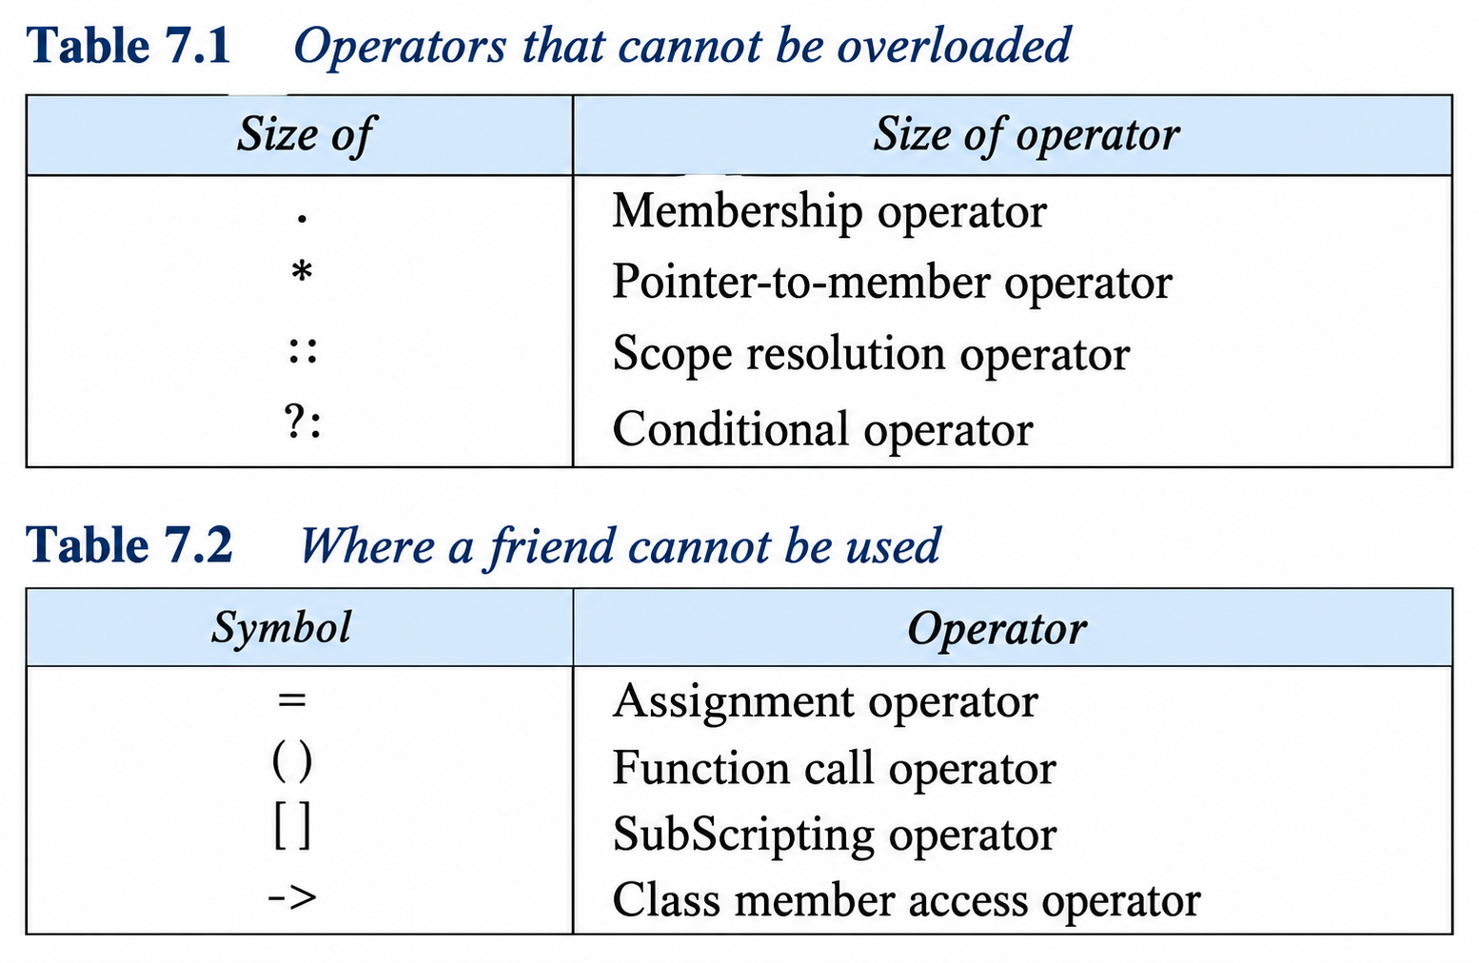
RULES FOR OVERLOADING OPERATORS

Slide 23
TYPE CONVERSIONS
Three types of situations might arise in the data conversion between uncompatible types:
Conversion from basic type to class type.
Conversion from class type to basic type.
Conversion from one class type to another class type.

Slide 24
TYPE CONVERSIONS
Conversion from basic type to class type.
The conversion from basic type to class type is easy to accomplish.
It may be recalled that the use of constructors was illustrated in a number of examples to initialize objects
For example, a constructor was used to build a vector object from an int type array.
Similarly, we used another constructor to build a string type object from a char* type variable.

Slide 25
TYPE CONVERSIONS
Conversion from basic type to class type.
Consider the following constructor:
string :: string(char *a)
{
length = strlen(a);
P = new char[length+1];
strcpy(P,a);
}
This constructor builds a string type object from a char* type variable a. The variables length and p are data members of the class string.

Slide 26
TYPE CONVERSIONS
Conversion from basic type to class type.
Once this constructor has been defined in the string class, it can be used for conversion from char* type to string type.
Example:
string s1, s2;
char* name1 = "IBM PC";
char* name2 = "Apple Computers";
s1 = string(name1);
s2 = name2;
The statement s1 = string(name1); first converts name1 from char* type to string type and then assigns the string type values to the object s1.

Slide 27
TYPE CONVERSIONS
Conversion from basic type to class type.
Once this constructor has been defined in the string class, it can be used for conversion from char* type to string type.
Example:
string s1, s2;
char* name1 = "IBM PC";
char* name2 = "Apple Computers";
s1 = string(name1);
s2 = name2;
s2 = name2; also does the same job by invoking the constructor implicitly.

Slide 28
TYPE CONVERSIONS
Conversion from Class to Basic Type
The general form of an overloaded casting operator function, usually referred to as a conversion function, is:
  Operator typename()
  { ....
  .....
  (Function statements)
  .....
  }
This function converts a class type data to typename.

Slide 29
TYPE CONVERSIONS
Conversion from Class to Basic Type
For example, the operator double() converts a class object to type double, the operator int() converts a class type object to type int, and so on.
Consider the following conversion function:
vector :: operator double()
{
double sum = 0;
for(int i=0; i<size;i++)
sum=sum+v[i]*v[i];
return sqrt(sum);
}
This function converts a vector to the corresponding scalar magnitude.

Slide 30
TYPE CONVERSIONS
Conversion from Class to Basic Type
The casting operator function should satisfy the following conditions:
  It must be a class member.
  It must not specify a return type.
  It must not have any arguments.

Slide 31
TYPE CONVERSIONS
Conversion from One Class to Another Class Type
Example:
objX = objY; //objects of different types
objX is an object of class X
objY is an object of class Y.
The class Y type data is converted to the class X type data and the converted value is assigned to the objX.
Since the conversion takes place from class Y to class X, Y is known as the source class and X is known as the destination class.

Slide 32
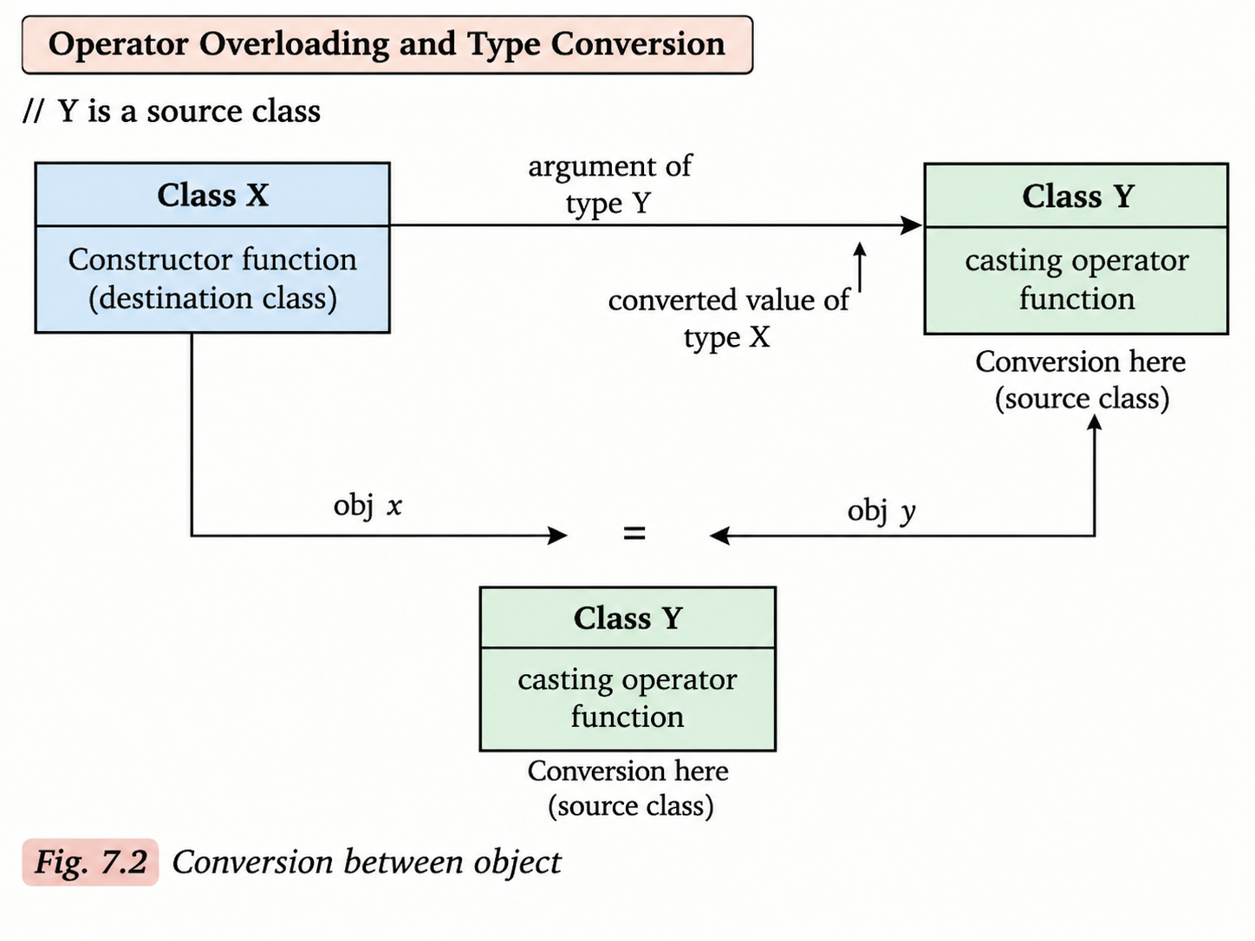
TYPE CONVERSIONS
Conversion from One Class to Another Class Type

